Slide 1
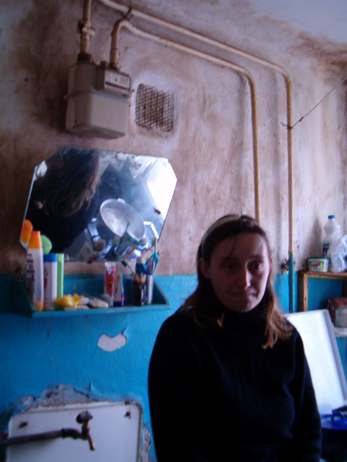
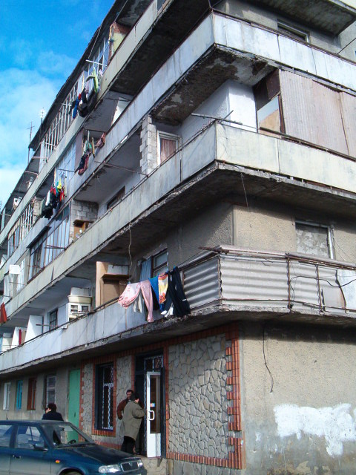
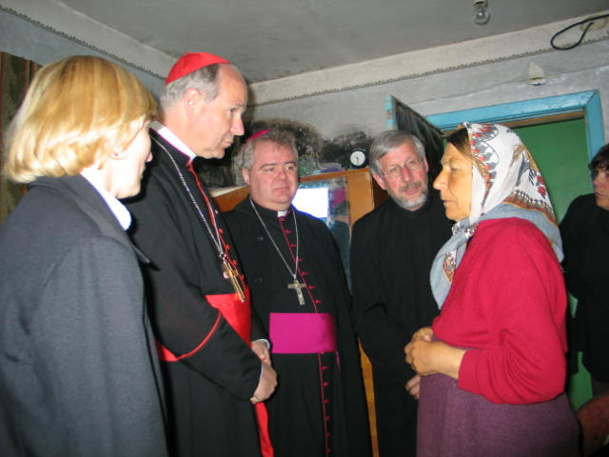
Visitig Moldavian “Titanic” – the house of the poor – Year 2004

Slide 2
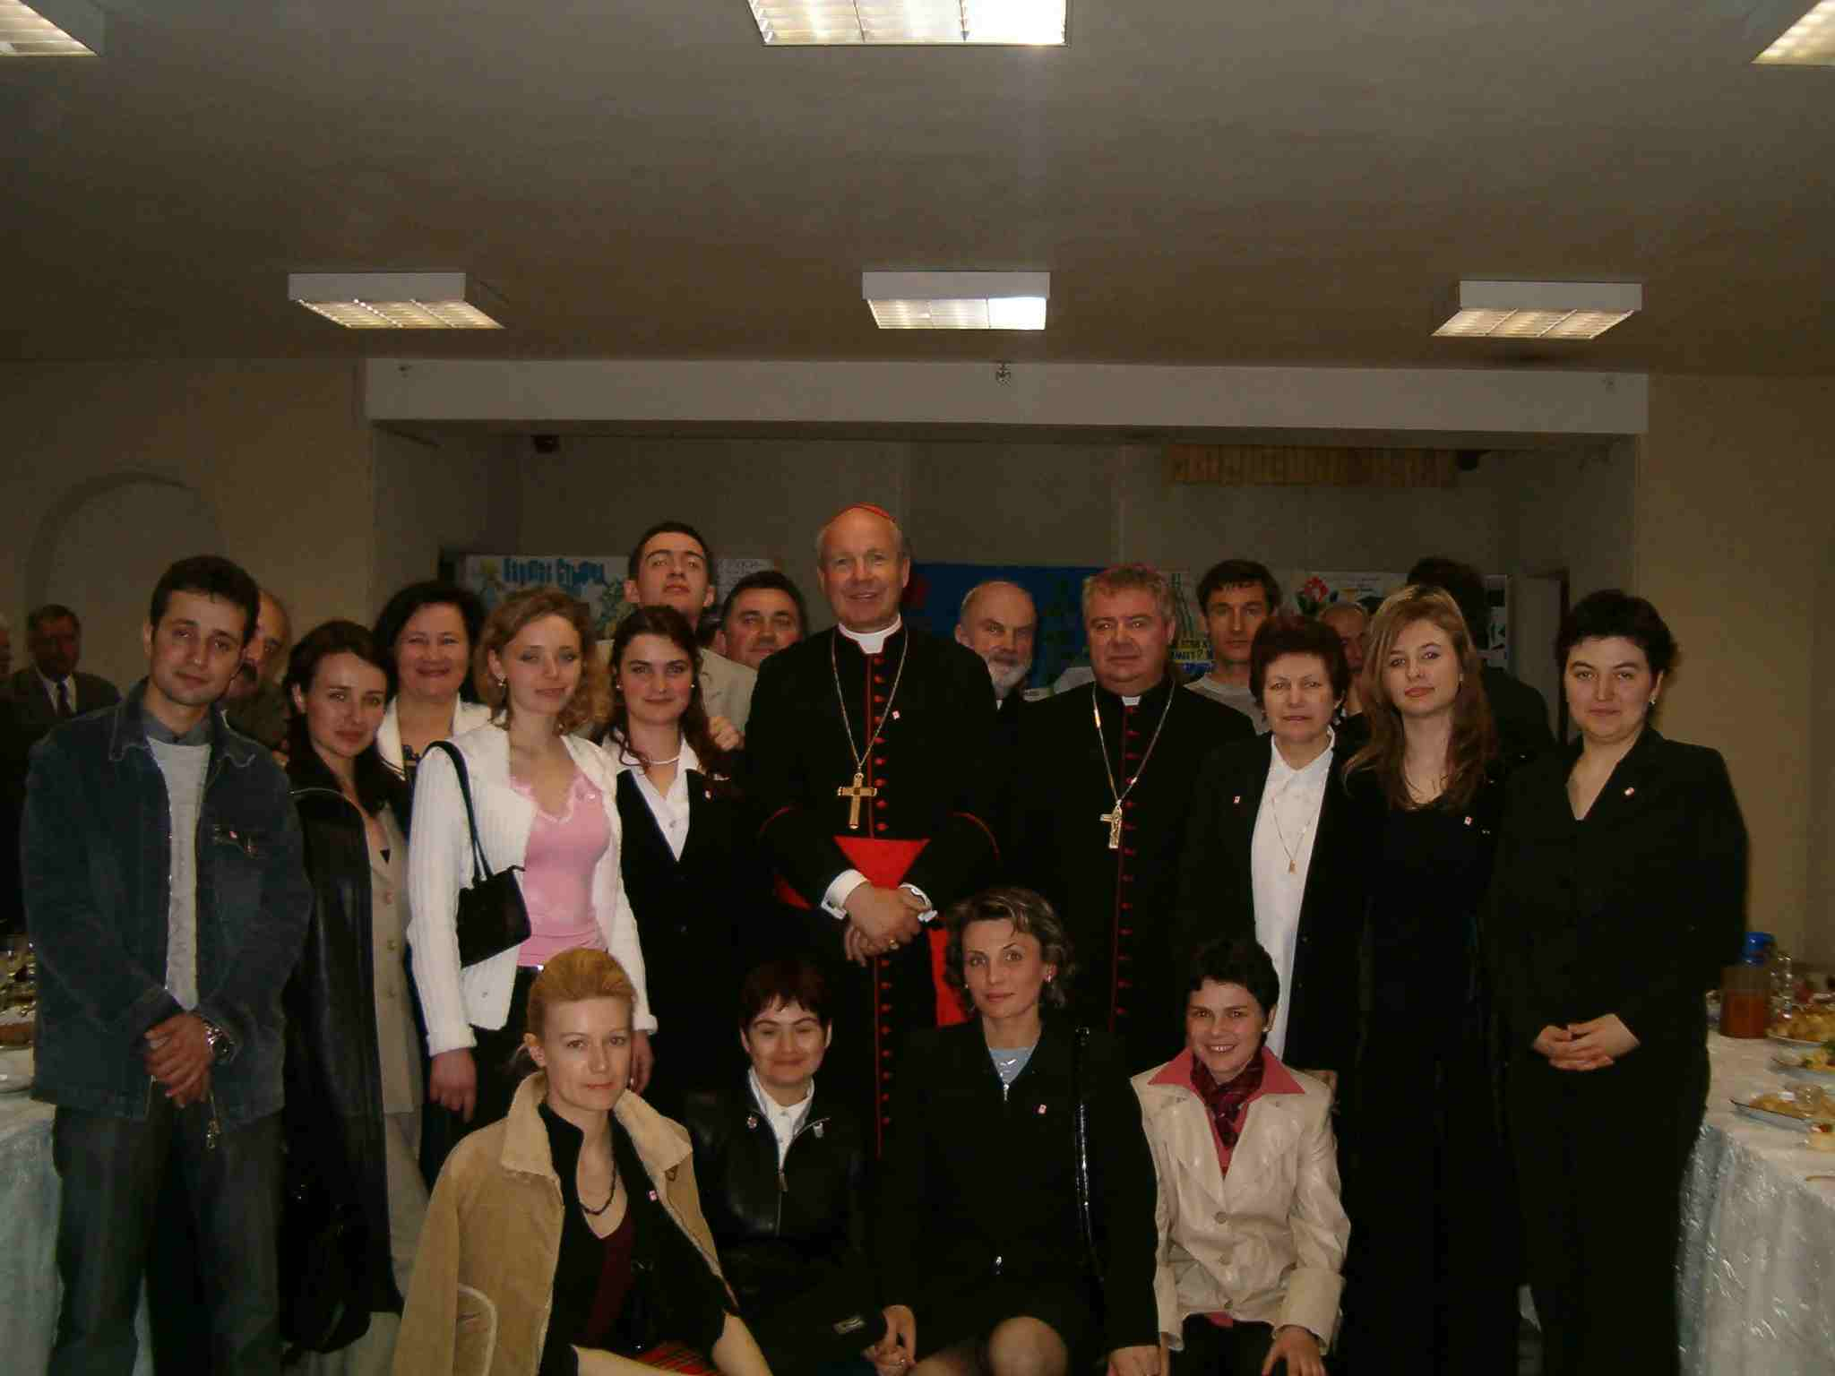
May 2005 –
Celebrating 10 years of Caritas Moldova

Slide 3
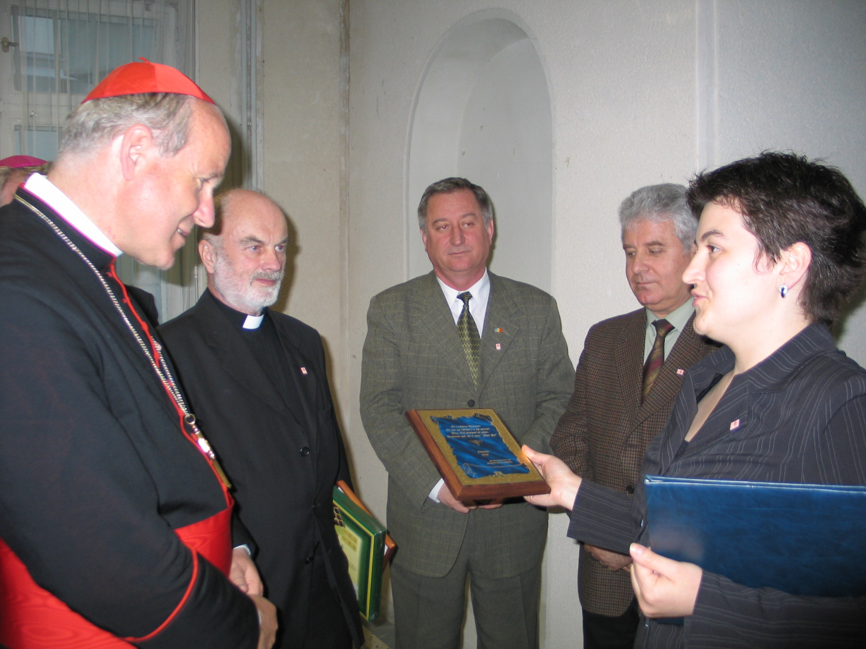
May 2005 –
Celebrating 10 years of Caritas Moldova

Slide 4
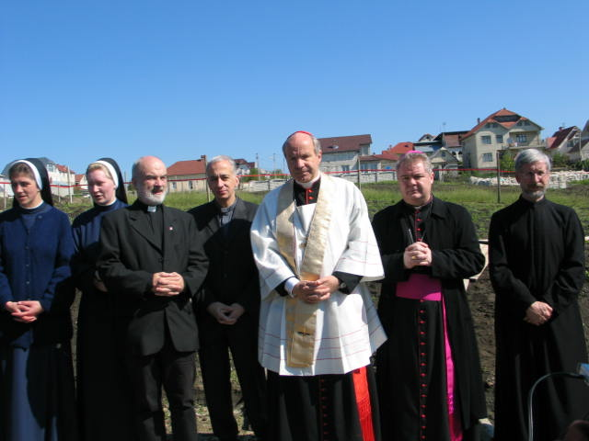
May 2005 – first stone for the homeless shelter

Slide 5
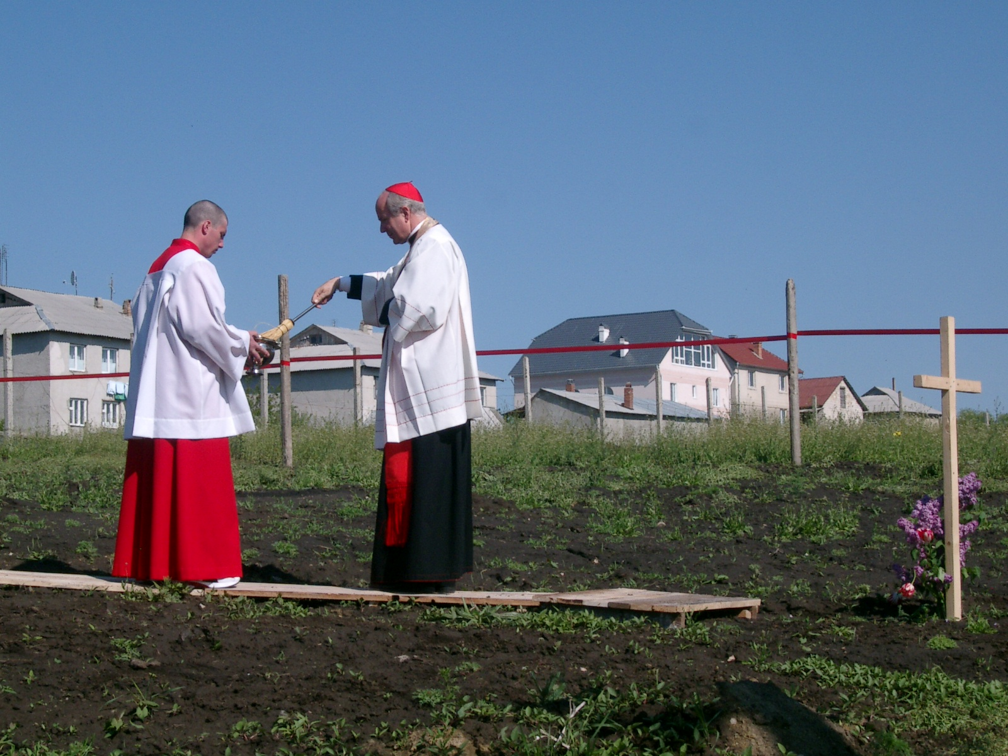
May 2005 –
first stone for the homeless shelter

Slide 6
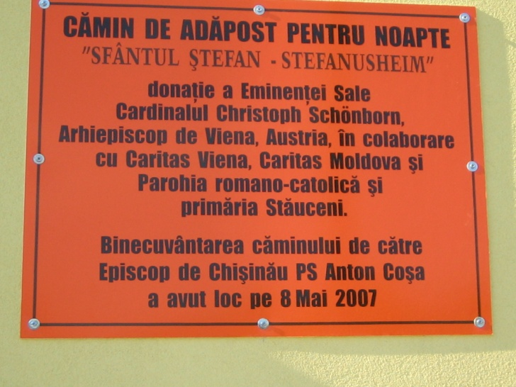
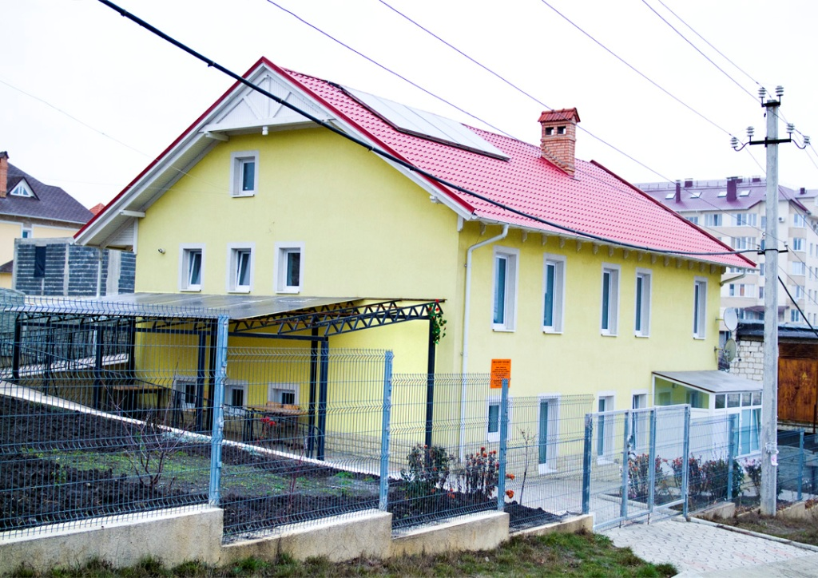
6 December 2006 – homeless center open to all

Slide 7


Slide 8
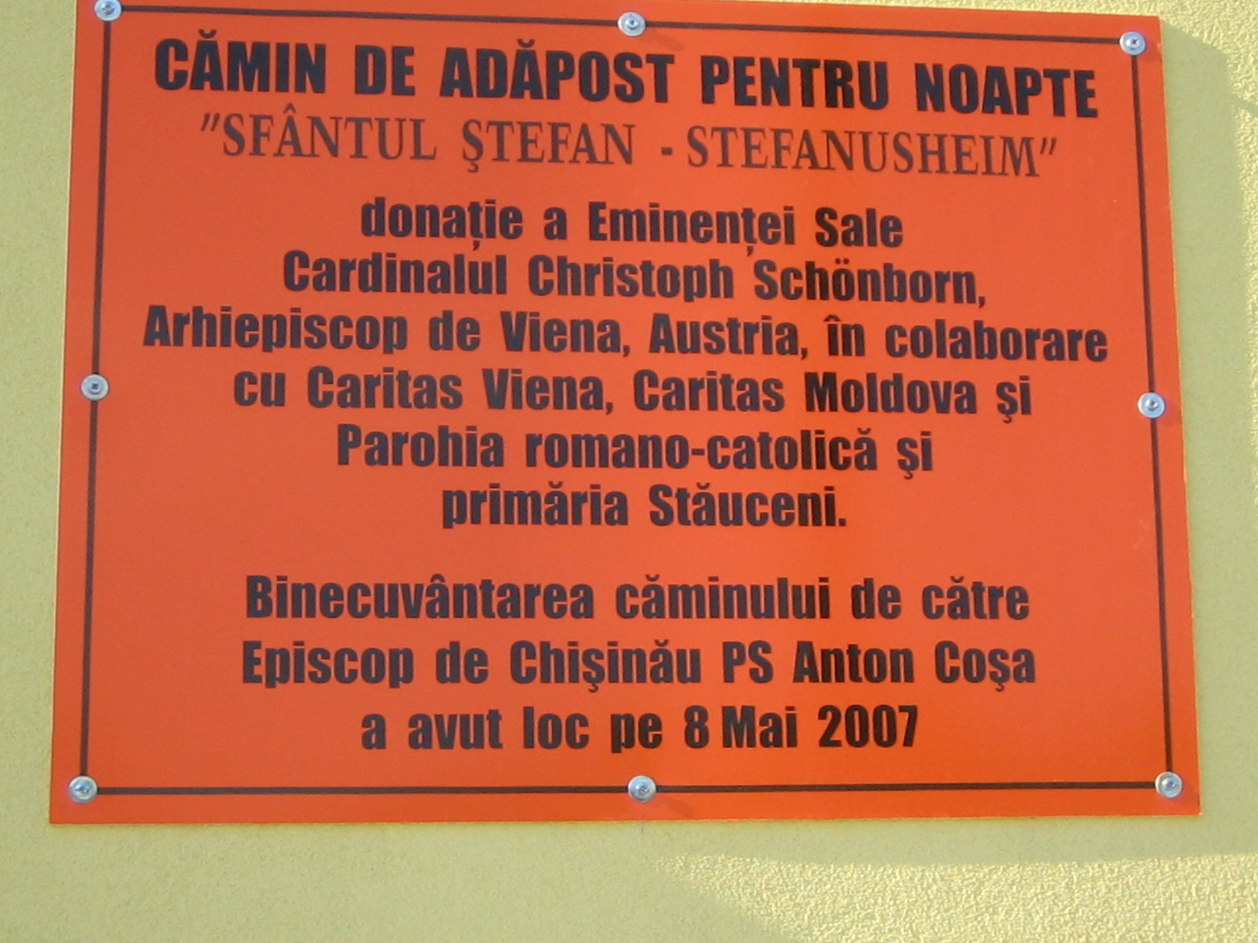
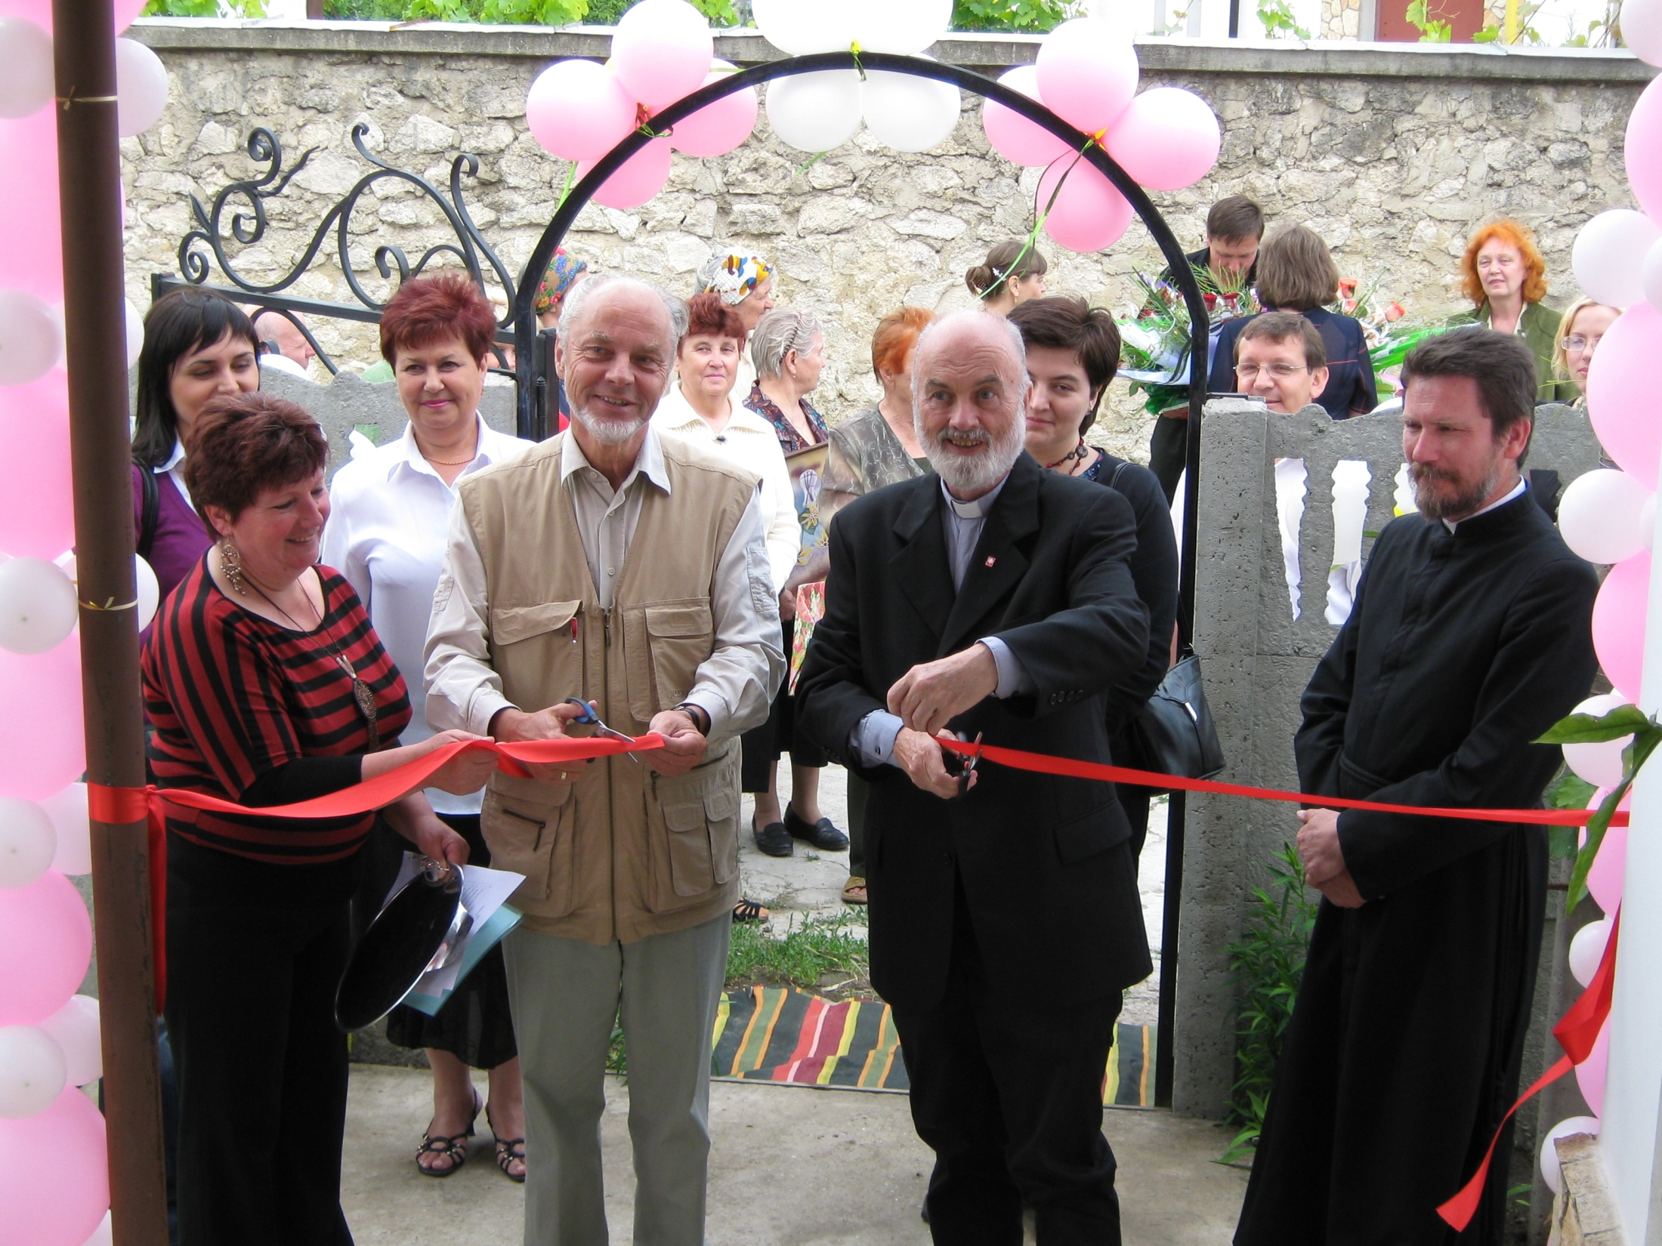
June 2009 – a new house of hope for elderly, Rabnita, Moldova

Slide 9
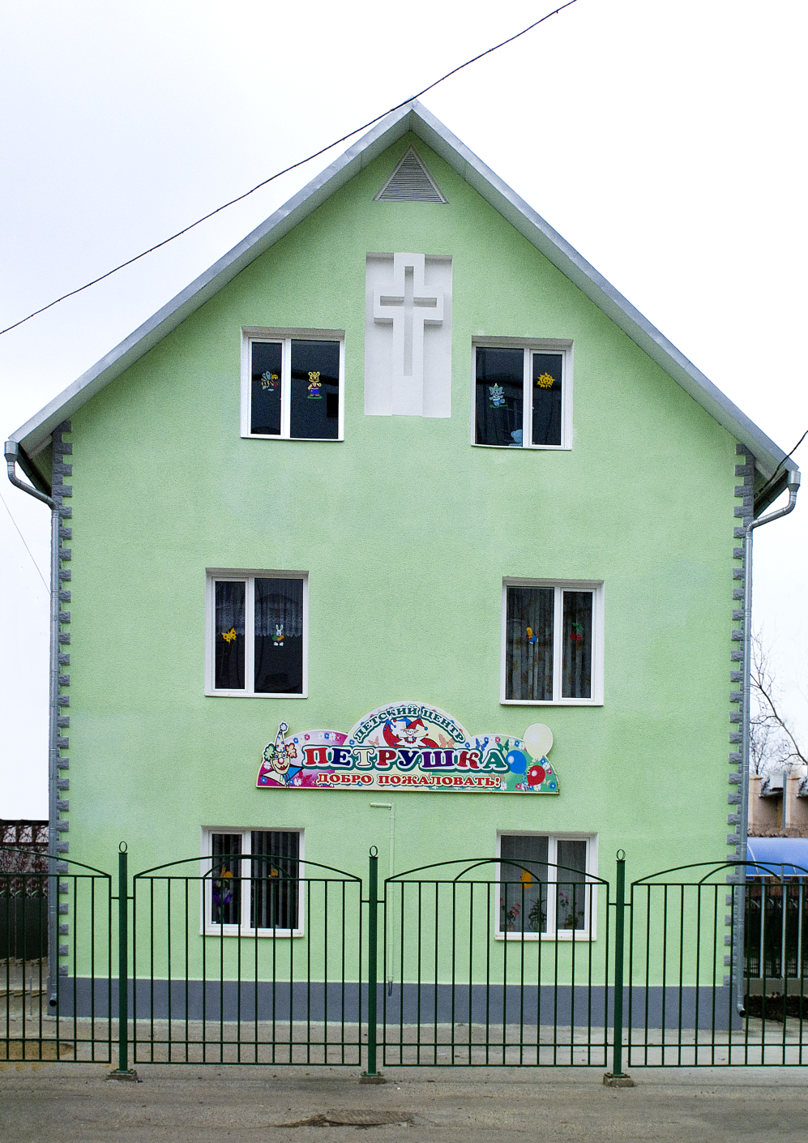

Helping street children in Tiraspol, Moldova

Slide 10

Happy birthday, your Eminency!

